Slide 1
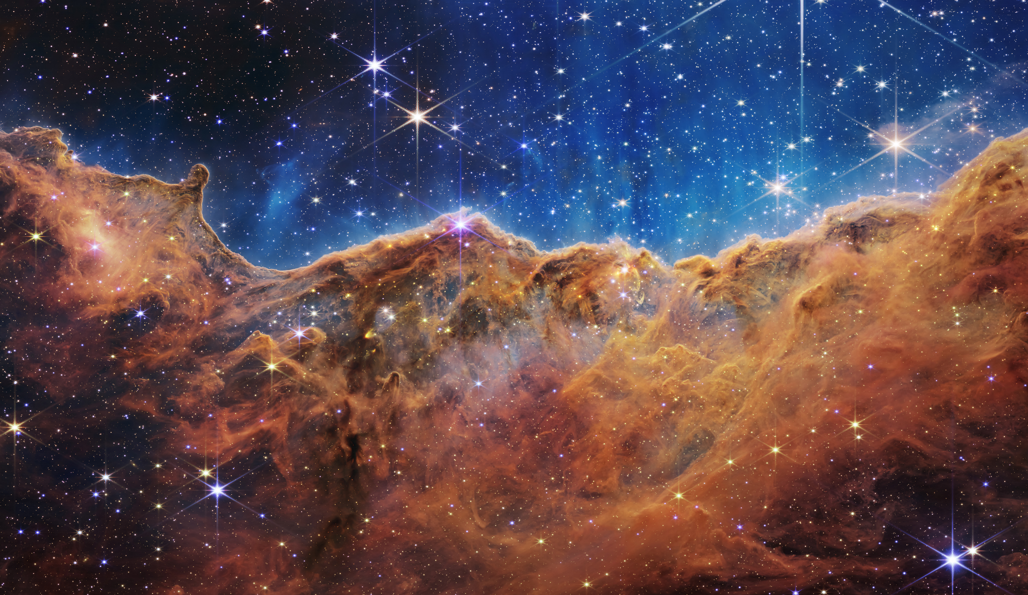
Physics & ASTRONOMY
Jeopardy!
Created by:
Image Courtesy of NASA

Slide 2
ALPHABET SOUP
EQUATIONS
PLANETS &
STARS
RELATIVITY
GENERAL
MISC
100
100
100
100
100
100
200
200
200
200
200
200
300
300
300
300
300
300
400
400
400
400
400
400
500
500
500
500
500
500
FINAL JEOPARDY
Notes:
Click on point values to see questions. Click on “Answer” to view answer, then click “Back” to return to the question board.
Alphabet Soup: Contestant is given a common physics-related acronym/abbreviation and must give the unabbreviated title. Tenure-Worthy: Upon viewing an equation, contestants must identify the scientist of origin (last name is acceptable) Name That Physicist: Contestants must use biographical clues to identify the correct physicist (last name is acceptable)
Relativity: All clues refer to a term related to relativity. Astronomy: All clues refer to a term related to astronomy. Misc: Definitions of miscellaneous physics terms.

Slide 3
ALPHABET SOUP
100
BACK
NASA
ANSWER

Slide 4
ALPHABET SOUP
100
NATIONAL AERONAUTIC & SPACE ADMINISTRATION
BACK
Notes:
President Dwight D. Eisenhower established NASA in 1958^{[10]} with a distinctly civilian (rather than military) orientation encouraging peaceful applications in space science.

Slide 5
ALPHABET SOUP
200
BACK
ISO
ANSWER

Slide 6
ALPHABET SOUP
200
INFARED SPACE OBSERVATORY
BACK
Notes:
As of March 2018, LIGO has made six detections of gravitational waves, of which the first five were colliding black-hole pairs. The sixth detected event, on August 17, 2017, was the first detection of a collision of two neutron stars, which simultaneously produced optical signals detectable by conventional telescopes.

Slide 7
ALPHABET SOUP
300
BACK
NSF
ANSWER

Slide 8
ALPHABET SOUP
300
NATIONAL SCIENCE FOUNDATION
BACK
Notes:
SONAR: a system for the detection of objects under water and for measuring the water's depth by emitting sound pulses and detecting or measuring their return after being reflected.

Slide 9
ALPHABET SOUP
400
BACK
LASER
ANSWER

Slide 10
ALPHABET SOUP
400
LIGHT AMPLIFICATION BY STIMULATED EMISSION OF RADIATION
BACK

Slide 11
ALPHABET SOUP
500
BACK
COSMOS
ANSWER

Slide 12
ALPHABET SOUP
500
COORDINATES, SIZES, MAGNITUDES, ORIENTATIONS, AND SHAPES
BACK
Notes:
PVC is the world's third-most widely produced synthetic plasticpolymer, after polyethylene and polypropylene.

Slide 13
EQUATIONS
100
BACK
ANSWER

Slide 14
EQUATIONS
100
ENERGY OF A LIGHT WAVE
BACK
Notes:
Newton also made pathbreaking contributions to optics, and he shares credit with Gottfried Wilhelm Leibniz for developing the infinitesimal calculus.

Slide 15
TENURE-WORTHY
200
BACK
ANSWER

Slide 16
EQUATIONS
200
HUBBLE’S LAW
BACK
Notes:
Hubble discovered that many objects previously thought to be clouds of dust and gas and classified as "nebulae" were actually galaxies beyond the Milky Way.

Slide 17
EQUATIONS
300
BACK
ANSWER

Slide 18
EQUATIONS
300
DOPPLER EFFECT
BACK
Notes:
In his book What Is Life? Schrödinger addressed the problems of genetics, looking at the phenomenon of life from the point of view of physics. He paid great attention to the philosophical aspects of science, ancient and oriental philosophical concepts, ethics, and religion.

Slide 19
EQUATIONS
400
BACK
ANSWER

Slide 20
EQUATIONS
400
SCHWARZCHILD RADIUS
BACK
Notes:
May also accept James Gregory.
The concept of a Taylor series was formulated by the Scottish mathematician James Gregory and formally introduced by the English mathematician Brook Taylor in 1715. If the Taylor series is centered at zero, then that series is also called a Maclaurin series, named after the Scottish mathematician Colin Maclaurin, who made extensive use of this special case of Taylor series in the 18th century.

Slide 21
EQUATIONS
500
BACK
ANSWER

Slide 22
EQUATIONS
500
DISTANCE MODULUS
BACK
Notes:
French physicist and mathematician who was one of the founders of the science of classical electromagnetism, which he referred to as "electrodynamics". He is also the inventor of numerous applications, such as the solenoid (a term coined by him) and the electrical telegraph. The SI unit of measurement of electric current, the ampere, is named after him.

Slide 23
PLANETS & STARS
BACK
100
THE PLANETS MAKE UP THIS PERCENTAGE OF THE MASS IN OUR SOLAR SYSTEM
ANSWER

Slide 24
PLANETS & STARS
100
.135%
BACK
Notes:
Planck made many contributions to theoretical physics, but his fame as a physicist rests primarily on his role as the originator of quantum theory, which revolutionized human understanding of atomic and subatomic processes.

Slide 25
PLANETS & STARS
BACK
200
THE CONDITION WHEN THREE CELESTIAL BODIES ARE ARRANGED IN A STRAIGHT LINE
ANSWER

Slide 26
PLANETS & STARS
200
SYZYGY
BACK
Notes:
She was the first woman to win a Nobel Prize, the first person and only woman to win twice, the only person to win a Nobel Prize in two different sciences, and was part of the Curie family legacy of five Nobel Prizes. She was also the first woman to become a professor at the University of Paris, and in 1995 became the first woman to be entombed on her own merits in the Panthéon in Paris.

Slide 27
PLANETS & STARS
BACK
300
THIS ACCOUNTS FOR APPROXIMATELY 85% OF THE MATTER IN THE UNIVERSE
ANSWER

Slide 28
PLANETS & STARS
300
DARK MATTER
BACK
Notes:
May also accept Susan Jocelyn Bell. Temporarily dubbed "Little Green Man 1" (LGM-1) the source (now known as PSR B1919+21) was identified after several years as a rapidly rotating neutron star.

Slide 29
PLANETS & STARS
BACK
400
THIS JUPITER MOON HAS 400 ACTIVE VOLCANOS
ANSWER

Slide 30
PLANETS & STARS
400
IO
BACK
Notes:
Hubble Space TelescopeThe Hubble Space Telescope as seen from the departing Space Shuttle Atlantis, flying Servicing Mission 4 (STS-125), the fifth and final Hubble mission
Mission typeAstronomyOperatorNASA · ESA · STScICOSPAR ID1990-037BSATCAT no.20580Websitewww.nasa.gov/hubble hubblesite.org www.spacetelescope.orgMission durationElapsed: 28 years, 2 months, 1 daySpacecraft propertiesManufacturerLockheed (spacecraft) Perkin-Elmer (optics)Launch mass11,110 kg (24,490 lb)^{[1]}Dimensions13.2 m × 4.2 m (43.3 ft × 13.8 ft)^{[1]}Power2,800 wattsStart of missionLaunch dateApril 24, 1990, 12:33:51 UTC^{[2]}RocketSpace Shuttle Discovery (STS-31)Launch siteKennedy LC-39BDeployment dateApril 25, 1990^{[1]}Entered serviceMay 20, 1990^{[1]}End of missionDecay dateestimated 2030–2040^{[3]}Orbital parametersReference systemGeocentricRegimeLow EarthSemi-major axis6,917.5 km (4,298.3 mi)Eccentricity0.000287Perigee537.4 km (333.9 mi)Apogee541.4 km (336.4 mi)Inclination28.47°Period95.47 minutes 1.35.25.83RAAN176.23°Argument of perigee82.61°Mean anomaly319.41°Mean motion15.09 rev/dayVelocity7.59 km/s (4.72 mi/s)EpochDecember 26, 2017, 13:18:33 UTC^{[4]}Revolution no.31,936Main telescopeTypeRitchey–Chrétien reflectorDiameter2.4 m (7.9 ft)^{[5]}Focal length57.6 m (189 ft)^{[5]}Focal ratiof/24Collecting area4.525 m² (48.7 sq ft)^{[5]}WavelengthsNear-infrared, visible light, ultravioletshowInstrumentsThe Hubble Space Telescope (HST) is a space telescope that was launched into low Earth orbit in 1990 and remains in operation. Although not the first space telescope, Hubble is one of the largest and most versatile.

Slide 31
PLANETS & STARS
BACK
500
SPACE SMELLS LIKE THIS
ANSWER

Slide 32
PLANETS & STARS
500
HOT METAL, DIESEL FUMES, AND BARBECUE
BACK
Notes:
a Dutch physicist who shared the 1902 Nobel Prize in Physics with Pieter Zeeman for the discovery and theoretical explanation of the Zeeman effect.

Slide 33
RELATIVITY
100
BACK
THESE WERE DETECTED BY LIGO AFTER TWO BLACK HOLES COLLIDED ONE BILLION LIGHT-YEARS AGO
ANSWER

Slide 34
RELATIVITY
100
GRAVITATIONAL WAVES
BACK
Notes:
first proposed by Henri Poincaré in 1905^{[1]} and subsequently predicted in 1916^{[2][3]} by Albert Einstein on the basis of his general theory of relativity.

Slide 35
RELATIVITY
THIS THEORY STATES THAT THE CURVATURE OF SPACETIME IS DIRECTLY RELATED TO THE E AND p OF MATTER PRESENT
200
BACK
ANSWER
Notes:
E: Energy. p: Momentum

Slide 36
RELATIVITY
200
GENERAL THEORY OF RELATIVITY
BACK
Notes:
Theorized by Albert Einstein, general relativity generalizes special relativity and Newton's law of universal gravitation, providing a unified description of gravity as a geometric property of space and time, or spacetime.

Slide 37
RELATIVITY
300
BACK
THE UNIVERSITY AT WHICH ALBERT EINSTEIN RECEIVED HIS DOCTORATE
ANSWER

Slide 38
RELATIVITY
300
UNIVERSITY OF ZURICH
BACK
Notes:
the emission of electrons or other free carriers when light shines on a material.

Slide 39
RELATIVITY
400
BACK
“EUREKA: A PROSE POEM” WRITTEN BY THIS POET INCLUDED A COSMOLOGICAL THEORY THAT PREDATES THE BIG BANG THEORY BY 80 YEARS
ANSWER

Slide 40
RELATIVITY
400
EDGAR ALLAN POE
BACK
Notes:
Eureka is Poe's attempt at explaining the universe, using his general proposition "Because Nothing was, therefore All Things are".

Slide 41
RELATIVITY
500
BACK
THIS STAR WAS USED IN 1920 TO FIRST OBSERVE GRAVITATIONAL BLUESHIFT
ANSWER

Slide 42
RELATIVITY
500
SIRIUS
BACK
Notes:
is a star system and the brightest star in the Earth's night sky.

Slide 43
GENERAL
100
BACK
THIS IS THE TERM USED TO DESCRIBE A STAR THAT HAS STABILIZED
ANSWER

Slide 44
GENERAL
100
MAIN-SEQUENCE STAR
BACK
Notes:
Main sequence stars fuse hydrogen atoms to form helium atoms in their cores. About 90 percent of the stars in the universe, including the sun, are main sequence stars. Thesestars can range from about a tenth of the mass of the sun to up to 200 times as massive.

Slide 45
GENERAL
200
BACK
A TYPE-II SUPERNOVA LEAVES THIS SUPER DENSE OBJECT IN ITS WAKE.
ANSWER

Slide 46
GENERAL
200
NEUTRON STAR OR BLACK HOLE
BACK
Notes:
Neptune is 17 times the mass of Earth

Slide 47
GENERAL
300
BACK
THIS TYPE OF TELESCOPE USES LENSES TO GATHER AND FOCUS LIGHT
ANSWER

Slide 48
GENERAL
300
REFRACTING TELESCOPE
BACK
Notes:
Nebulae are often star-forming regions, such as in the "Pillars of Creation" in the Eagle Nebula. In these regions the formations of gas, dust, and other materials "clump" together to form denser regions, which attract further matter, and eventually will become dense enough to form stars.

Slide 49
GENERAL
400
BACK
THIS STAR APPEARED TO DIM SIGNIFICANTLY IN 2020
ANSWER

Slide 50
GENERAL
400
BETELGUESE
BACK
Notes:
While many asteroids are composed primarily of rock and metal, most Kuiper belt objects are composed largely of frozen volatiles (termed "ices"), such as methane, ammonia and water.

Slide 51
GENERAL
500
BACK
THIS ROVER SINGS HAPPY BIRTHDAY TO ITSELF EVERY YEAR
ANSWER

Slide 52
GENERAL
500
CURIOSITY
BACK
Notes:
The total cost of building, launching, landing and operating the rovers on the surface for the initial 90-sol primary mission was US$820 million.

Slide 53
MISC
100
BACK
THE SI UNIT OF CAPACITANCE
ANSWER

Slide 54
MISC
100
FARAD
BACK
Notes:
for example a gas heated in a rigid container: the pressure and temperature of the gas will increase, but the volume will remain the same.

Slide 55
MISC
200
BACK
THE NAME OF THIS THEORY IS DERIVED FROM VIEWING SUB-ATOMIC PARTICLES AS 1-DIMENSIONAL OBJECTS, NOT AS POINTS
ANSWER

Slide 56
MISC
200
STRING THEORY
BACK
Notes:
Because string theory potentially provides a unified description of gravity and particle physics, it is a candidate for a theory of everything, a self-contained mathematical model that describes all fundamental forces and forms of matter.

Slide 57
MISC
300
BACK
OCCURS WHEN THE INCIDENT ANGLE IS GREATER THAN THE CRITICAL ANGLE
ANSWER

Slide 58
MISC
300
TOTAL INTERNAL REFLECTION
BACK
Notes:
This is particularly common as an optical phenomenon, where light waves are involved, but it occurs with many types of waves, such as electromagnetic waves in general or sound waves

Slide 59
MISC
400
BACK
IF TWO OBJECTS HAVE THE SAME MASS THEIR CENTER OF GRAVITY IS LOCATED AT THIS POSITION.
ANSWER

Slide 60
MISC
400
HALFWAY BETWEEN THEM
BACK
Notes:
Bouchet was also among the first 20 Americans (of any race) to receive a Ph.D. in physics and was the sixth to earn a Ph.D. in physics from Yale.

Slide 61
MISC
500
BACK
THE PRINCIPLE THAT SAYS TWO WAVE FUNCTIONS BEHAVE AS IF THEY CAME FROM A SINGLE SOURCE
ANSWER

Slide 62
MISC
500
COHERENCE
BACK
Notes:
The amount of coherence can readily be measured by the interference visibility,

Slide 63
FINAL JEOPARDY
TOPIC
BACK
OPTICS
QUESTION

Slide 64
FINAL JEOPARDY
QUESTION
BACK
THIS FORM OF LIGHT OCCURS WHEN PARTICLES ABSORB ENERGY AND DO NOT IMMEDIATELY RE-EMIT THAT RADIATION
ANSWER

Slide 65
FINAL JEOPARDY
ANSWER
PHOSPHERESCENCE
END
Notes:
The amount of coherence can readily be measured by the interference visibility,

Slide 66
THANK YOU FOR PLAYING
Thanks for playing
Physics & ASTRONOMY
Jeopardy!
Created by:
Image Courtesy of NASA

